Slide 1
Digital Transformation & Business Agility

Slide 2
Agenda
Introduction
The meaning of Business Agility
Microsoft & Apple: Digital Transformation & Business Agility
IAG BTS: The Self-Organizing Transformation
CBA Kaching: Creating A $9 Billion Digital Channel
J.P. Morgan & Spotify: Cutting Out Frozen Middle-men
Lessons Learned & Appendices

Slide 3
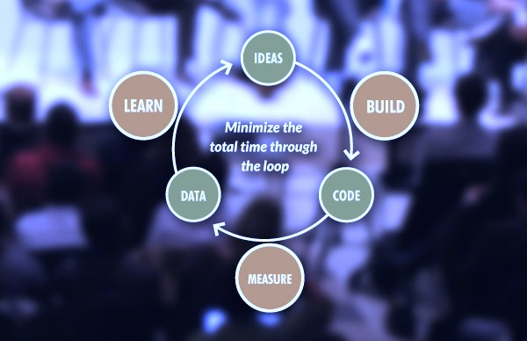
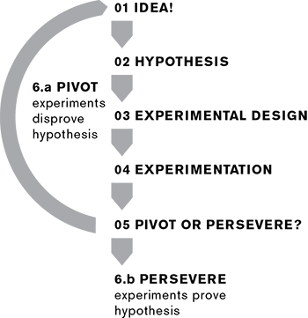
Lean Startup is an Agile learning loop. Pivot until profit.
Continuous Integration and Experimentation.
LEARN
BUILD
MEASURE
Notes:
What happened with “statement”?

Slide 4
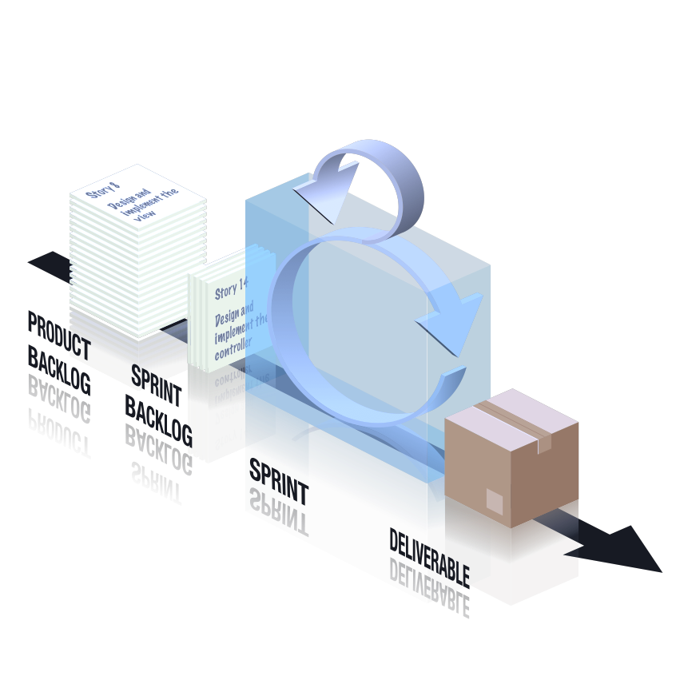
Scrum is double-loop. Learning what to do and how.
Productivity as a deliverable. Continuous improvement.
RETROSPECTIVE
FEATURE DELIVERY TEAM
OR SQUAD OR SCRUM
Notes:
What happened with “statement”?

Slide 5
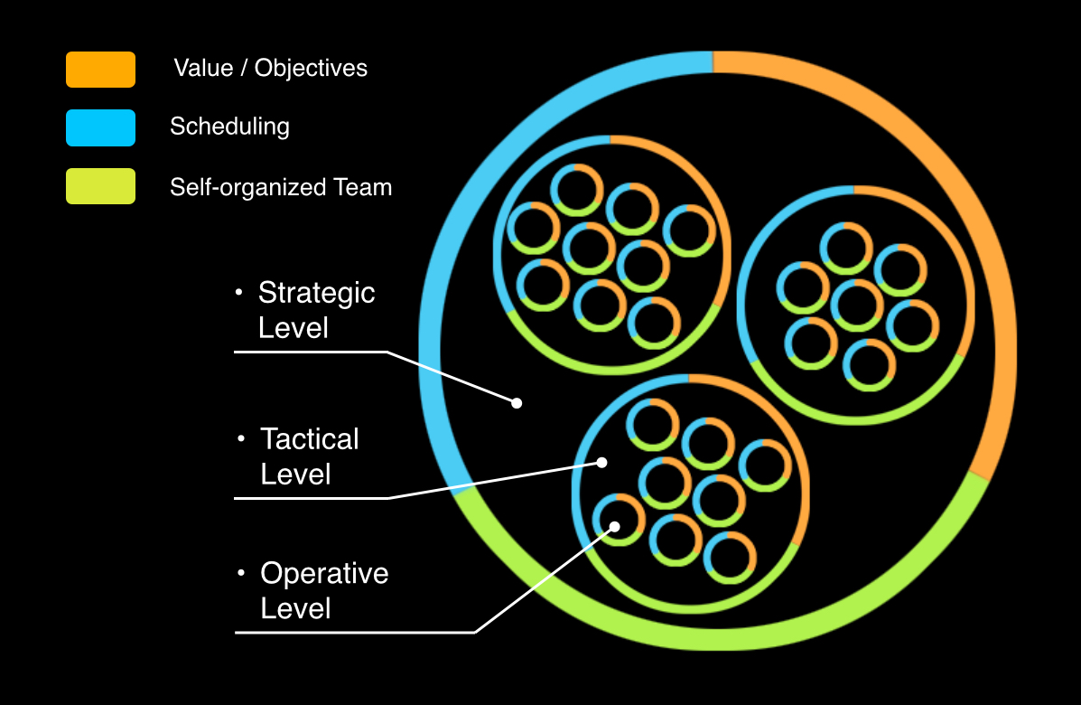
Business Agility is triple-loop. Organisation as deliverable.
Continuous adaptation of teams to products to markets.
Build
Why, Who
& When
Measure
Learn
Value Stream
How Teams
Deliver
Product
Feature
What Teams
Deliver
Notes:
The relationship between process, team structure, and value stream function.
Processes
Impact Mapping
Acceptability Matrix
Backlog Bingo
Release Refactoring
Story Mapping
Scrumban
BDD
CD
Structure
Strategic Execution
Strategy Mapping

Slide 6
Microsoft 2006. Digital but not Agile.
Zune
Internet Explorer
Windows ME/Vista
The Ribbon …

Slide 7
On its way to a Kodak Moment?

Slide 8
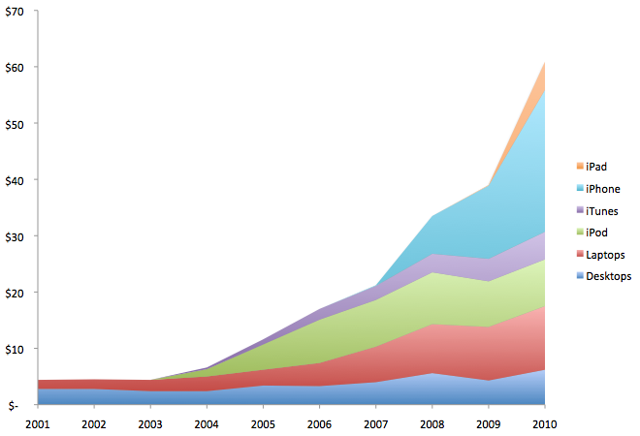
Apple thought different

Slide 9
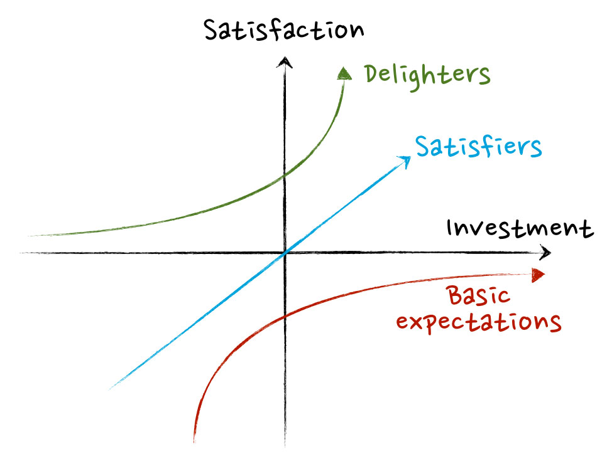
Because Kano
Disruption
Deception
Digitalization
Demonetization
Democratization
Dematerialization
Notes:
What happened with “statement”?

Slide 10
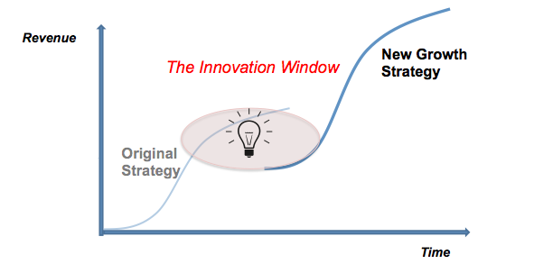
Kodak died staying the course.
Microsoft stagnated meeting the market.
All growth strategies
are S-curves.
Notes:
What happened with “statement”?

Slide 11
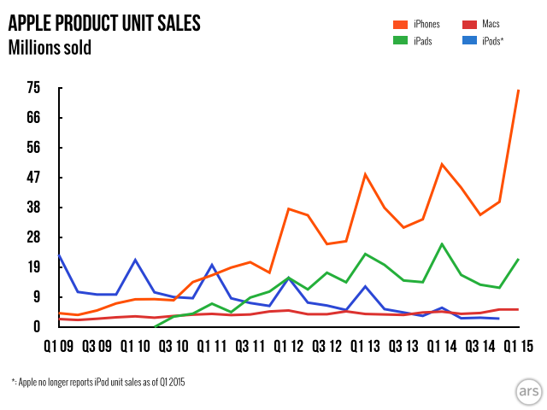
Apple obsoleted the market.
So now it’s worth more than Russia.
Notes:
What happened with “statement”?

Slide 12

But this isn’t a delighter.
Notes:
What happened with “statement”?

Slide 13

Now Microsoft is thinking different.
Notes:
What happened with “statement”?

Slide 14
“Microsoft were Digital in 2006. In 2016 the whole
organisation has become Agile.” – Steven Denning

Slide 15
Lesson: Digital Transformation needs Business Agility

Slide 16

IAG 2009: No more business as usual
Late into digital channels
Losing market share
Losing brand affinity
Ponderous release cycle
Unresponsive siloed structure

Slide 17
First Digital Products “Troubled”
1. Home Insurance Sales Online
12 Weeks Late
40% over budget
1394 Defects
“Scrumbut” Process
Confused Project with Product
2. Customer Loyalty Bonus
Agile showed Bus. case flawed
Cancelled without pivoting
Manager scapegoated & sacked
Team member reputations sullied

Slide 18

Why?
Teams mixed progressives & conservatives
Neglected technical enablers
Teams changed process mid-flight
No realistic deployment path
Collisions in shared testing environments
No alignment of organization to Agile
Inadequate executive support
Inadequate cultural awareness

Slide 19
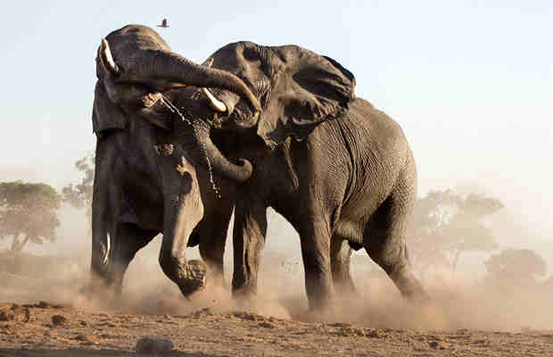

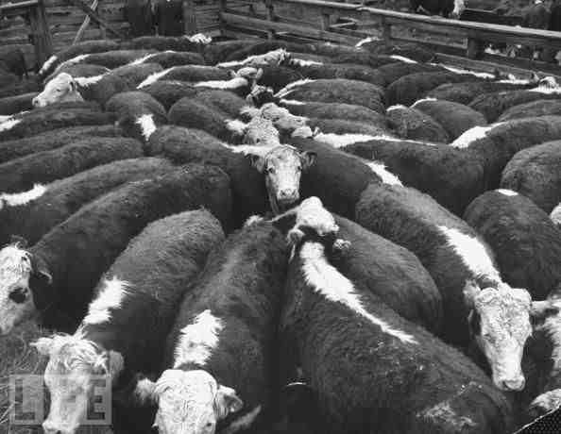
What were we trying to do?
Scaled Agile
Agile Holarchy
Alignment
Waterfall
Waterfall + Agile
Autonomy

Slide 20
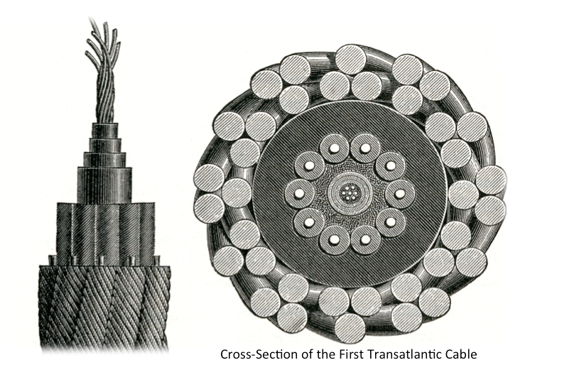
How do we generate holarchy?
Start with a metaphor: “steel thread squads”.
Use metrics to prove and grow capability iteratively.
Using Agile to make Agile. No compromise. No confusion.
Notes:
What happened with “statement”?

Slide 21
AWAKE
ALIGN
ASSIST
ACCELERATE
ASSESS
ALLOCATE
APRIL
JULY
SEPTEMBER
FEBRUARY
STRATEGY
COORDINATION
BCF
BCF
BCF
DELIVERY
IRT
IRT
IPH
NCL
IIP
SUPPORT
OPERATIONS
21

Slide 22







Why?
Disruption
Technical Debt
Self-Organizing Transformation
Big Transformation Up Front
Time
Time
Integrity
Productivity
Time
Time

Slide 23
Lesson: Use Agile to become Agile.
Let change recipients become change agents.
Disruption
Technical Debt
Self-Organizing Transformation
Big Transformation Up Front
Time
Time
Integrity
Productivity
Time
Time

Slide 24
CBA 2012: Kaching breaks the mold
R27 Business Issues
Business unprepared for Agile
Negotiation over collaboration
Missing strategic coordination
Business making solution choices
R27 Delivery Team Issues
Sprint over-commitments
Team context-switching
Delivery failing to maintain visibility
No consistent feature estimation process
R27 Technical Issues
Vague & missing acceptance criteria
No mitigation of downstream dependencies
No automated test / environment mgmt

Slide 25
2nd Release A Huge Improvement
400% increase in project throughput over the life of the release.
Project went green across the board in PSG - first time ever.
Project over-delivered – brought 2 significant features forward into the 28.0 release from 28.x (T&Cs, Out-of-App Collections).
R28.0 released on time with no heroics, 26 minor defects assigned to patch, only 1 sev-2 discovered since release
“Kaching For Everyone” – a major new business case initiated, negotiated, detailed and estimated in 28.0 without any disruption to delivery work
Business Manager and Tech. BAs in collaborative engagement through planning activities at all levels
How?

Slide 26
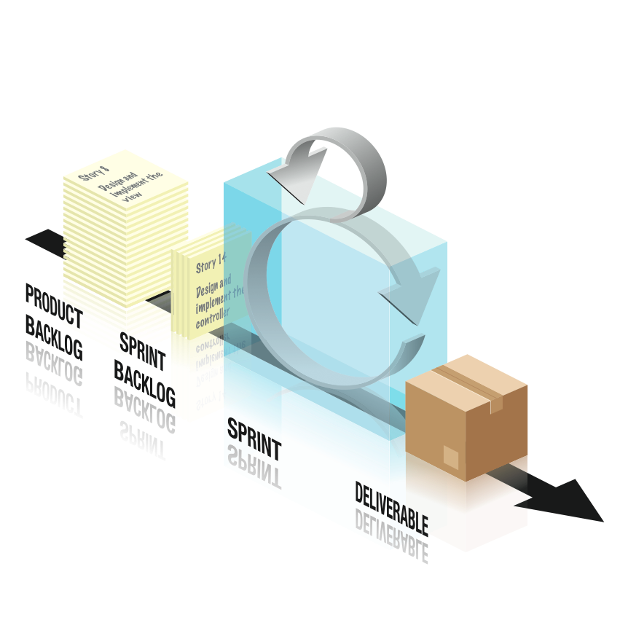
Breadth-first Agile Product Management
Business Case
Stakeholders
CX/UX
Epic list
PRODUCT PLANNING TEAM
IMPACT MAP
& UX DESIGN
FEATURE /
THEME MAP
BUSINESS BINGO ESTIMATION & PRIORITIZATION
RELEASE REFACTORING

Slide 27
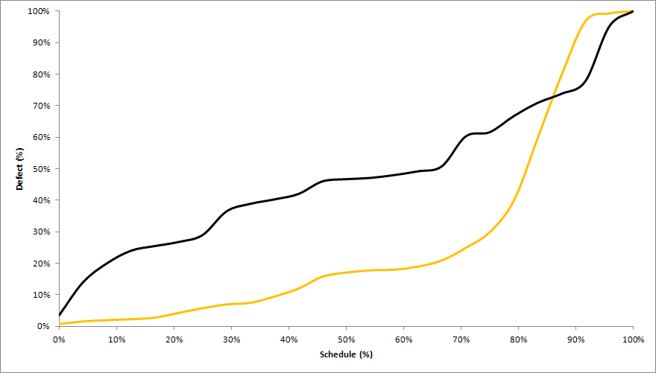
Continuous Integration, Virtual Environments
>50x in prod
“Deferred Quality”
Kaching R28
47%
>25x
All other R28
17%
>10x
>2x
Relative Cost of a Defect
X

Slide 28
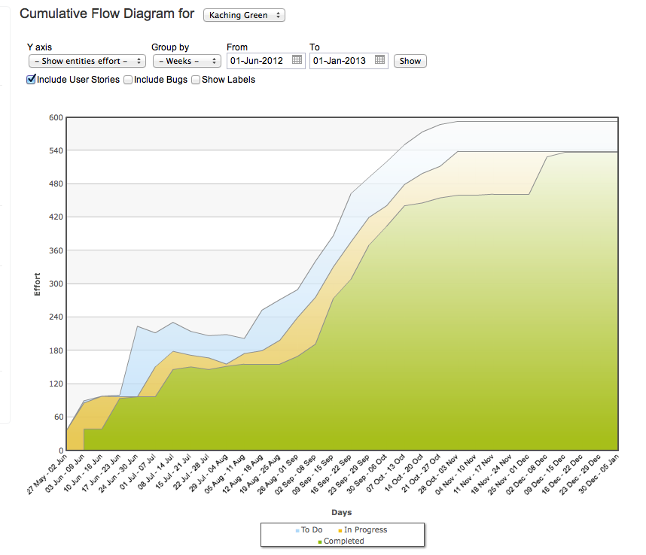
3rd Release: Enter “Hot-Fix Hell”
29.1 Release
28.4 / 29.0 / 29.1 Hotfixing
tracked in QC.
28.1
Patch
28.3 Patch / Hotfix
28.2
Patch

Slide 29
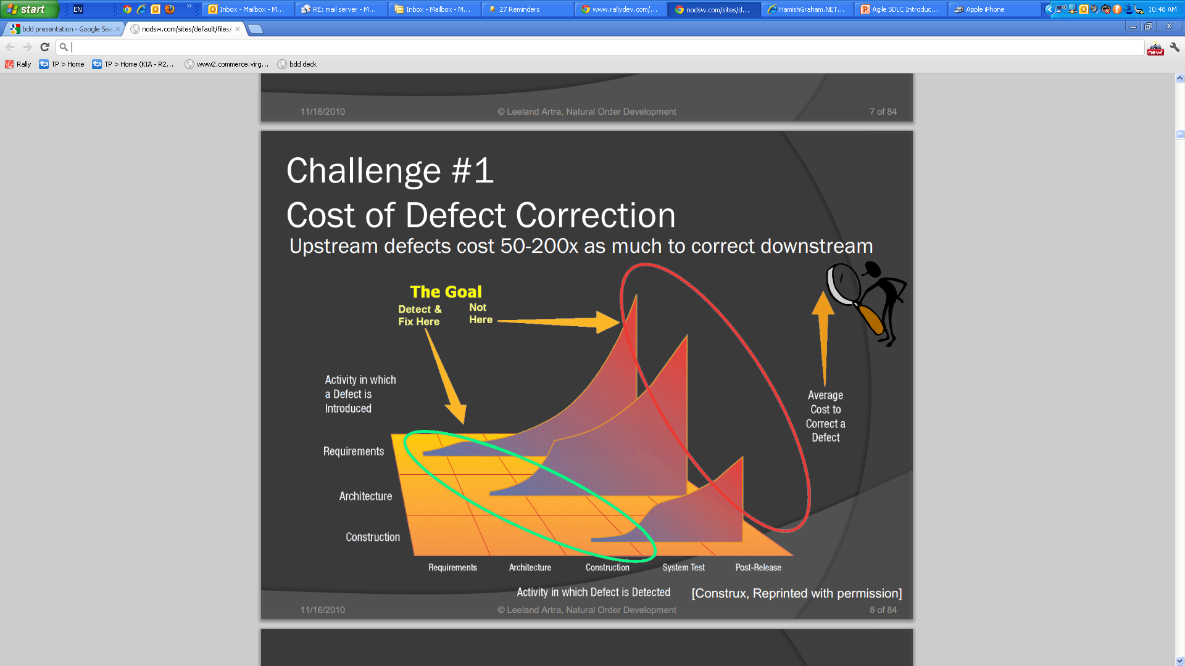
Why?

Slide 30
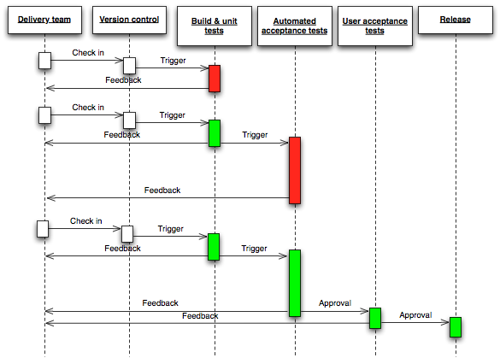
4th Release introduced Quality Automation
New Test / New Code
Continuous
Integration
Automated
Programmer
Tests
Automated
Acceptance
Tests
Human
Acceptance
Tests
Automated Deployment
BDD
FIT/SIT

Slide 31
Kaching: A $9 Billion Digital Channel
ABFM award for "Most Innovative Retail Banking
Product" 2012, 3 AIMIA awards in 2013 for best app in
Innovation, Effectiveness and Financial Industry,
Group CIO award for best program in the bank.

Slide 32
Lesson: Deliver products depth-first.
Manage them breadth-first.
ABFM award for "Most Innovative Retail Banking
Product" 2012, 3 AIMIA awards in 2013 for best app in
Innovation, Effectiveness and Financial Industry,
Group CIO award for best program in the bank.

Slide 33










Given the many proof points, Agile is no longer the domain of start-ups. Over 80% of global organizations deliver using Agile.
84% have delivery projects using Agile approaches
37% of organisations use Agile for ¾ or more of their products
Most large Australian organisations are investing in Agility programs:
Top 3 reasons cited to adopt Agile :
accelerating time to market
manage changing priorities
better aligning IT and business objectives
Notes:
Discussion: What are your key drivers for adopting agile?

Slide 34
But … Beware The Frozen Middle!
PMs track budgets, baselines, spec sign-offs, risk register, critical path, CRs, phase gates, environment deployment, resource and tech dependencies, individual tasking & reviews, RACI and timesheets.
Self-managing feature teams don’t use those things. Continuous integration, continuous delivery, continuous improvement of ROI-prioritized, fully spec’ed, tested, well documented product features, one after another like clockwork, servant-led.
Execs see the benefits in better ROI, lower cost of change, more transparency, faster risk reduction. Doers enjoy collaboration, autonomy, life balance.
But proper Agile tracks products, not projects. It has POs, not PMs. It has holarchy, not hierarchy …

Slide 35
J.P. Morgan Chase: A Drastic Solution
“In Agile, some people just can't make the journey. We started by
sacking all middle managers.” – Paul Gladigau, CIO, JP Morgan Chase
“Large Scale Scrum @ J.P. Morgan”
Larman & Winn, InfoQ 2014
“Managers aren’t responsible for project or feature delivery. Feature teams
self-manage to deliver items prioritized by a business-side Product Owner.”
“Self-managing teams make all important team decisions – including hiring
and firing – themselves. Command and control are replaced by coaching and mentoring.”

Slide 36
“Sed Quis Custodiet Ipsos Custodes?” – Decimus Juvenal
“Not Managers. Directly Responsible Individuals.” – Steve Jobs
Scaled Agile Framework’s identifies DRIs and an Agile RACI …
Spotify Engineering Culture aligns Tribes to Products …

Slide 37
“We can scale our Agile cake and eat it.”
SAFe + Spotify + Leadership as a Service: XSCALE
Community Leaders
Team: 2 - 10 people
Community: 4 - 20 people
Value Stream: 10 - 100 people
Business Owners
Lean Program Teams
Epic Owners
Customer Reps
Solution Architects
Product Owner & Scrum Master
Product Manager
Value Stream Eng.
Business & Tech Guilds
Analysts
Value Stream Team
Product Portfolio Management
Agile Delivery Teams
Testers
Designers
Coaching Guild
Developers
Enterprise Architect & Portfolio Eng.
System Architect & RT Engineer
Communities
Agile Release Trains
DevOps System Teams
Process Automation
Production Support
…
© Peter Merel, 2016
Stream 2
Stream 3

Slide 38
What have we learned?
Build
Why, Who
& When
Measure
Learn
Value Stream
How Teams
Deliver
Product
Feature
What Teams
Deliver
Notes:
The relationship between process, team structure, and value stream function.
Processes
Impact Mapping
Acceptability Matrix
Backlog Bingo
Release Refactoring
Story Mapping
Scrumban
BDD
CD
Structure
Strategic Execution
Strategy Mapping

Slide 39
Lessons Learned
Microsoft:
Digital Transformation needs Business Agility.
Apple:
Measure and stack ROI S-Curves to obsolete markets.
IAG BTS:
Self-organizing change coaches recipients into agents.
CBA Kaching:
Manage products breadth-first. Deliver depth-first.
JP Morgan, SAFe, Spotify, XSCALE:
Business Agility cuts out the middle manager.
Why, Who
& When
How Teams
Deliver
What Teams
Deliver
Notes:
The relationship between process, team structure, and value stream function.
Processes
Impact Mapping
Acceptability Matrix
Backlog Bingo
Release Refactoring
Story Mapping
Scrumban
BDD
CD
Structure
Strategic Execution
Strategy Mapping

Slide 40
Thank You

Slide 41
Additional Information
Appendix A: About Mozaic
Appendix B: Further Reading
Appendix C: Sponsor Guidelines
Notes:
Hopefully the preceding discussion gave you a broad brush overview of our capabilities. What I’d like to turn to now is our specific experience in the higher education sector.

Slide 42
Appendix A: About Mozaic 1 of 2
We strive to be the first choice for:
Clients looking for pragmatic ‘fit for purpose, cost effective solutions that deliver demonstrable business value’ and
Affiliates looking for a culture and flexible environment where they can thrive
Our mission
Who we are
Our approach
How we work
We are senior professionals with deep expertise gained in the corporate and professional services world.
Our approach is centered around a “Trusted Partner” Model” - adopting client problems as our own and being passionate about delivering pragmatic solutions that add value.
We take pride in our collaborative approach “teaming” with our clients and creating an environment and culture where our affiliates are passionate about their work and are valued for their contribution..

Slide 43
Appendix A: About Mozaic 2 of 2
We have a broad range of offerings that leverage our collective “Know-how” and the varied experience of our senior professionals.
Project Resourcing
Project Delivery
Project Advisory
Business Advisory
Program Directors
Large Scale Program + Change Management
Project QA
Sourcing Advice
Program Managers
Program Shaping & Planning
Project Maturity Assessments
IT Strategy and Architecture
Business Architects
Operating Model Design and Implementation
PM Capability Uplift
Digital Strategy
Solution Architects
Outsourcing,
cloud Transition
EPMO Design & Implement
Agile Delivery & Transition
Senior Project Managers
PMO Establish + Operate
Business Case Development
Post Merger Integration
Change Managers
PMO Assessment
Package Implementation
Application Portfolio Mgt.
Business Analysts
Shared Service Implementation
Portfolio Planning
Application Competency Centre Design
PMO Resources
PM Coaching
Project Mobilisation
Cloud Assessments
Testing Resources
Digital
Testing Transition
System Selection
Notes:
In the years we have been in business we have performed a wide range of consulting engagements.
What I’ve highlighted in blue are those services that we’ve provided in Higher Ed.
During the case studies I will be drilling down on a number of these areas but happy to answer any specific questions you might have.

Slide 44
Appendix B - Agile Capability & Further Reading
Presentations available
Role of project sponsor - Senior Executive Briefing: Getting the Most out of Agile Projects
Document reviews and signoff accountabilities - The roles of 'Approver', 'Reviewer' and/or 'For Information’; and the implications of delegation.
Defining the Agile roles on the project - how we reconcile the Agile roles of 'Product Owner'; 'Scrum Master' with other traditional project roles defined within our clients.
The role of the Business Analyst in defining and representing Product and Sprint backlog items
The essential role of Architecture on agile projects
Effective use of Test Teams on Agile projects
Change Management and Agile Projects
For more information, we recommend the following reading:
Succeeding with Agile – Mike Cohn
The Limits of Agile (in a mainframe environment), Alan Kelly
Agile in a COBOL World, Roger Brown
Agile Contract Models for external suppliers, Ilan Goldstein
Distributed Scrum Primer for working with offshore teams, Pete Dreemer
Agile Success Factors, Scott Ambler
The Manager and Scrum – Pete Dreemer
What Agile Teams Think of Agile Principles, Laurie Williams
Scrum Guide – the definitive guide to scrum, Ken Schwaber
Scrum Shortcuts without cutting corners, Ilan Goldstein
Use cases are not requirements, Steve Meyer
Evidence based scheduling, Joel Spolsky
The Skeptic’s Guide To Low-Fidelity Prototyping, Laura Busche
Mixing Agile with Waterfall for Code Quality, Ben Linders
Impacts of Organizational Factors on Software Quality, Mathieu Lavallée
Examining the "Big Requirements Up Front Approach” Scott Ambler

Slide 45
Appendix C : Sponsor Guidelines 1 of 2
As an Executive Sponsor : Challenge the Team
Challenge the team’s Release Plan & Approach:
What prototypes could we use to validate requirements or benefit assumptions earlier in the project’s life-cycle, before development commences?
What is the smallest feature set that we could go-live with so that they could solicit feedback?
What could we go live with while development continues?
What could we deliver early to help us learn more about our customers?
What pilot options are there?
Insist on seeing early working prototypes to confirm that they are aligned with your expectations
Attend ‘Sprint Showcases / Iteration Reviews’ where possible, or request separate demonstrations. This is an opportunity to see the raw results of work being achieved; it will give you a better sense of the project’s progress; and an opportunity to communicate priorities and clarify direction.

Slide 46
Appendix C : Sponsor Guidelines 2 of 2
As an Executive Sponsor : Support the Team
Meet with the team both up-front; and on a regular basis to communicate the objectives, background and priority of the project; and the relative priorities of key features
Ensure that you have a sufficiently trusted representative, allocated to the project, if not full-time then at least with sufficient time to provide day-to-day feedback and prioritisation to the team (‘Agile Product Owner’).
Ensure that your day-to-day representative on the project (‘Product Owner’) is aligned with your views of relative priorities of key features. Insist on reviewing these priorities together, in detail.
Be supportive of the team if/when early prototypes fail. These early failures are less expensive and more easily able to be corrected than the failures of traditional-style projects. Ideally these will help the project deliver a better quality outcomes over the course of the project.
Help resolve issues – particularly issues that the team can’t resolve on their own such as availability of key resources, engagement of key suppliers, and priority from other internal supplying teams.
Be clear about the amount of time you personally may (or may not) have available to allocate to the project
Actively endorse the retrospective/learning process (overleaf)

Slide 47

Whilst some organisations have chosen to take an all-in approach to agile transformation we advocate “starting small” on either a visible or stealth project
Options for transitioning to Agile
Starting Small
Going All In
Less Expensive
Early success is likely
Less Risk
Less stressful
Obviates need to re-organise
Can reduce resistance
Avoid problems of scrum and traditional teams working together
Implemented more quickly
?
Visible pilot
Stealth project
Transformations are a complex human activity, multi-dimensional, inherently conflicted and very dynamic. We recommend an “Agile” iterative, progressive approach with adaptive prioritisation

Slide 48
The selection and delivery of the pilot is a key step on the agile journey
Acceleration | Architecture | Assistance | Awareness | Alignment | Assessment
1. Assessment and Alignment- Business Agility Current State Diagnostic
Identify & deliver high-priority candidate project to showcase agile delivery approach to senior stakeholders
Embed agile practices and showcase approach to internal teams.
Identify key learnings
Progressively extend to other teams
4.Document Learnings and Next Steps
Agile Diagnostic & Assessment:
2. Readiness - Training and Coaching
Internal:
Identify & document key learnings and any Agility Roadblocks encountered including
Stakeholder perceptions of current agility, innovation & speed to market
Current state of agile practice
IT technical readiness (CI/CD/Automation)
Structured Training:
Aligned to globally recognised Scrum Alliance syllabus
Certified Scrum Master, Certified Product Owner
3. Showcase Agile Delivery & Capability Uplift
Coaching & Advice:
Agile coaching & support to new teams sponsors & stakeholders
IT & business teams
Process, system, governance, culture

